Slide 1
Owning Your Data Story
Created By: Jeffrey A. Shaffer Vice President, Unifund Adjunct Faculty, University of Cincinnati (513) 615-0001 | JeffreyShaffer@gmail.com @HighVizAbility
Notes:
Title Slide

Slide 2
Owning Your Data Story
Storytelling with Data

Slide 3


owning your data story
Notes:
As we prepare for the final projects, consider these points in your visualizations and presentations.

Slide 4
Information Glut
90% of surveyed professionals admit to having thrown away information without reading it. The average consumer processes 100,500 digital words daily Source: measuring consumer Information (International Journal of Communication)
Notes:
When we started this class we talked about the world being filled with data. We process huge amounts of data, but in a recent survey, they found that we throw away most of the information without reading it. So there is a finite amount of data that someone will consume and we are competing to attention with our visualizations.

Slide 5
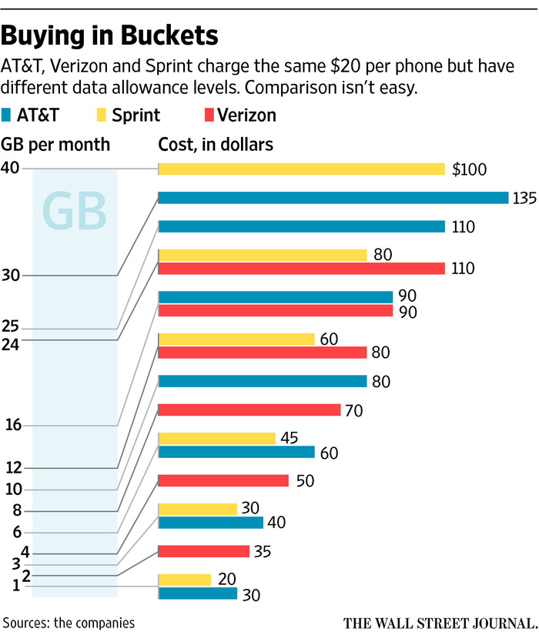
Notes:
Let’s looks at this example from the Wall Street Journal. They are attempting to compare the costs and GB usage for the top three wireless carriers. Unfortunately this is very difficult to process. Readers will likely give up on this quickly and there’s a risk of coming away with the wrong conclusions. The y-axis labels are not aligned with the bars and the distance between 1 and 2 GB seems to be the same as the distance between 30 and 40 GB. What’s the best deal for a consumer? Can you tell?

Slide 6

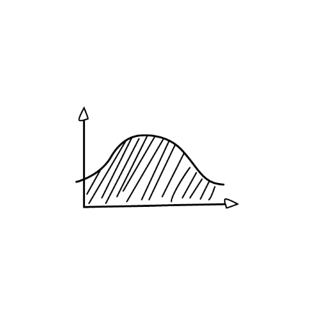



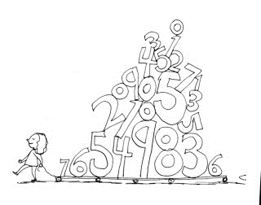


“There is no such thing as information overload. There is only bad design.”
-Edward Tufte
Tableau
Notes:
Edward Tufte said, there’s no such thing as information overload. There is only bad design. We’ll come back to the wireless example and see if we can redesign it to tell a better story.

Slide 7





Storytelling!
Notes:
First, let’s talk about Storytelling. In this course you were introduced to Cole Nussbaumer who wrote Storytelling with Data. I would encourage you to check out her book and her website, storytellingwithdata.com. But why is storytelling important?

Slide 8




MATH
STORIES
Notes:
We often hear about the left brain and right brain, a mental separation between a “math brain” and a “creative brain”. But it’s more complicated than that.

Slide 9
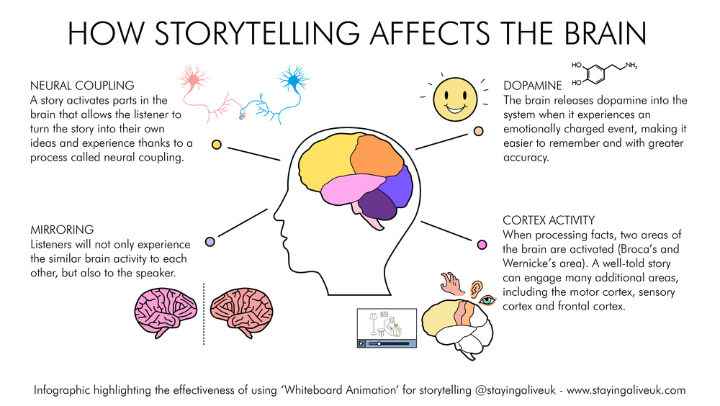
Notes:
There have been scientific studies that have shown that storytelling affects the brain. A story activates parts of the brain that allow the listener to turn the story into their own ideas and experience. Listeners will experience similar brain activity as others and the speaker. In addition, the brain releases dopamine when experiences an emotionally charged event, making it easier to remember and with greater accuracy. And finally, when processing facts, the brain is activated in two primary areas, but when engaged in a well-told story there are many more areas of the brain activated.

Slide 10
Elements of Storytelling
Notes:
Let’s look at the elements of storytelling.

Slide 11

Attract
Engage
Punchline
Notes:
At the highest level, we are trying to Attract the audience, Engage with the audience and deliver a Punchline.

Slide 12

Laws of Attraction
Identify theme
Know your audience
Determine purpose
Set the tone
Keep it simple
Notes:
The Laws of Attraction:
Identify the theme. Who’s the audience and what’s the message? Set the tone and keep it as simple.

Slide 13
Rules of Engagement
Interactive vs. non-interactive
Choice of visualizations
Pay attention to size, colors, space
Purposeful arrangement
Walk audience through the story (how you deliver)
Notes:
Rules of Engagement:
Is the viz interactive or static? For the final projects you will be creating an interactive visualization, but as you create visualizations in the future, keep this in mind. What is the best choice for the visualization to display the data? Pay close attention to the use of color, but also size and the use of space. Make sure the arrangement is purposeful.
Walk the audience through the story.

Slide 14

Give ‘Em the Punchline
Conclude clearly
Place your conclusion strategically
Chronologically
Lead with the punchline
Make a lasting impression
Notes:
Make sure the purpose is clear. Step back from your visualization and ask yourself, so what? What is the user supposed to take from your visualization? What purpose did it server? Is that clear? Place your conclusions strategically and don’t be afraid to lead with the punchline. We want to make a lasting impression, but let’s try to do that in a good way.

Slide 15
Don’t give them 4, give them 2+2
Andrew Stanton - Pixar Director, Screenwriter, and Producer
Ted Talk: “The Clues to a Great Story”
Notes:
Andrew Stanton, Director at Pixar, has a great TED talk “The Clues to a Great Story”. He says, “Don’t give them 4, give them 2+2”.

Slide 16

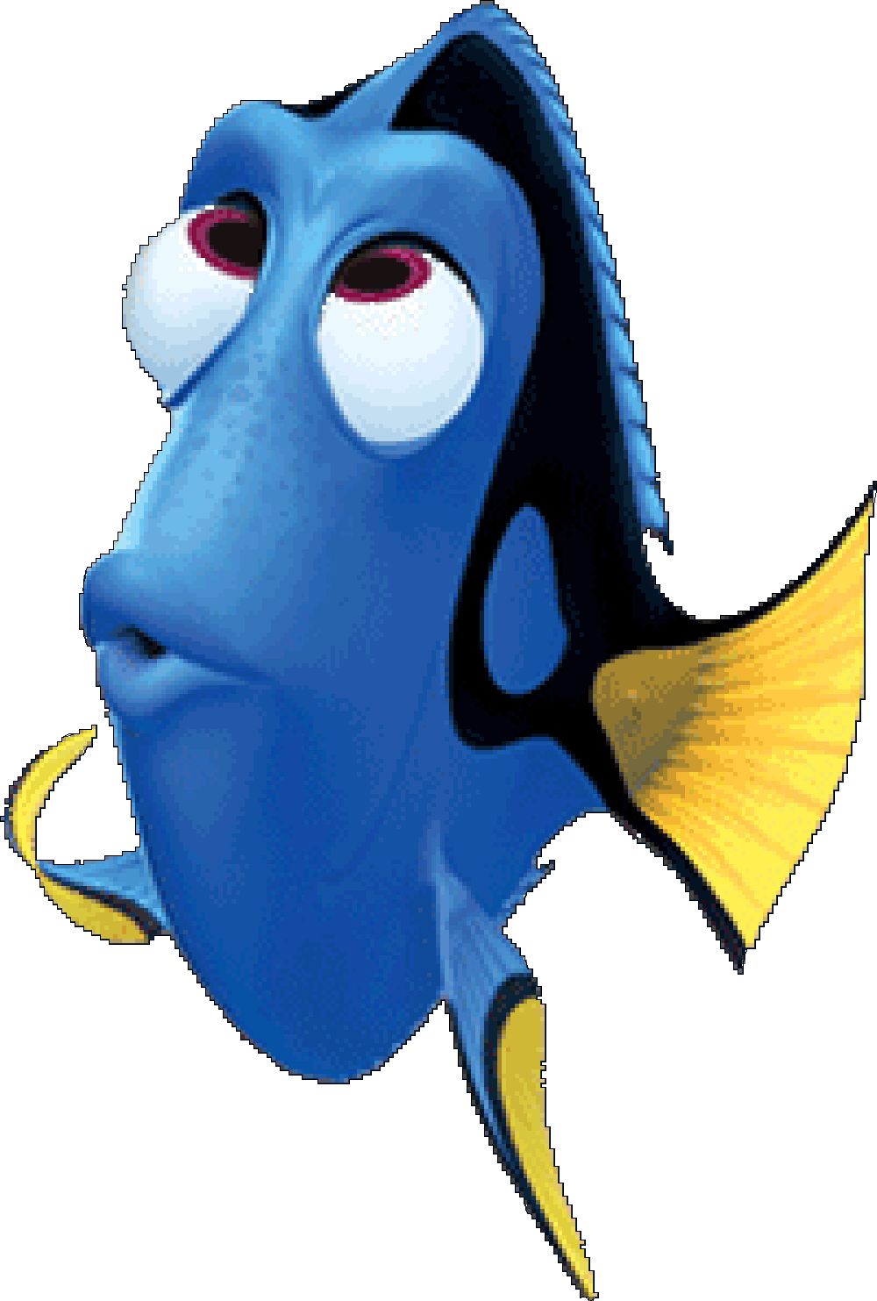


Notes:
If we look at one of Pixar’s tremendously successful movies, Finding Nemo, we see exactly that. The punchline is in the title of the movie. It’s about, “Finding Nemo”. But the movie doesn’t simply show Nemo lost and then found. Instead, it’s about the long journey it takes to find Nemo.

Slide 17
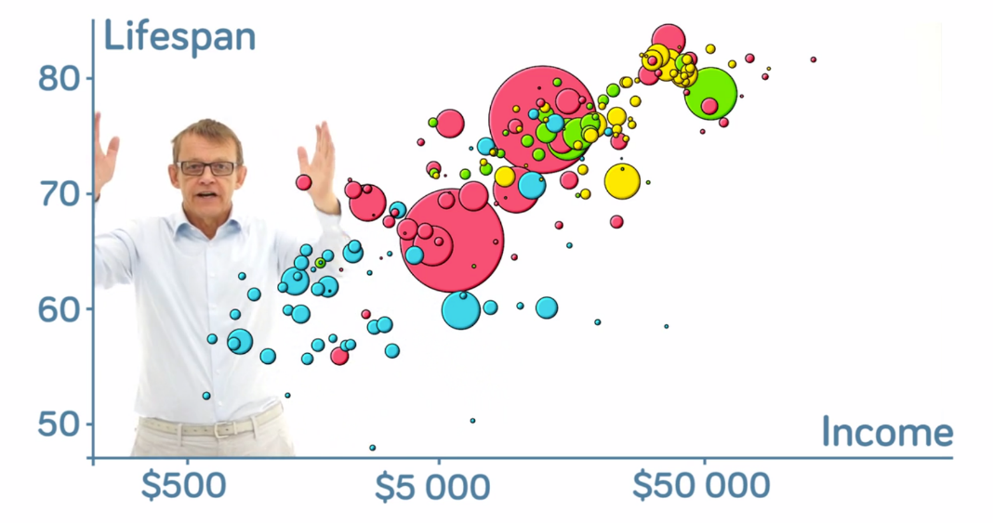
“The Best Stats You’ve Ever Seen”
Notes:
In Module 7, we watch Hans Rolsing’s TED talk and we built his Gapminder viz in Tableau. Let’s breakdown this amazing talk.

Slide 18


Hans Rosling Presentation Breakdown
Attract
Engage
Punchline
Are we really not smarter than chimpanzees?
Debunk third world myths
Show why preconceived notions are wrong
Animation of countries’ progress over the course of 200 years
Walks us through journey
Highlight key historical events that audience may relate to
We need to have open, searchable databases to allow people to see reality
Promote a fact-based view of the world
Notes:
There is no doubt that Hans Rosling attracts attention right from the beginning. He talks about the students and professors being on par with the chimpanzees and debunks third world myths. He explains that it’s not ignorance, but rather preconceived notions and brings data to the rescue.
He Engages the audience by using animations of the countries and walks us through the journey offering real-time commentary as the chart is animating, and he highlights important aspects of the data that people can relate to.
He states his punchline early, “I realized there was really a need to communicate the data.” And he continues to reference throughout his talk and wraps up the talk, discussing the importance and need for more open data and promoting a fact-based view of the world.

Slide 19

“Numbers have an important story to tell. They rely on you to give them a clear and convincing voice.”
Stephen Few
Notes:
Stephen Few said, “Numbers have an important story to tell. They rely on you to give them a clear and convincing voice.”

Slide 20

Let’s Re-Design!
Notes:
So let’s go back and look at the wireless example from The Wall Street Journal.

Slide 21
Notes:
Here’s the data in a table. We can see that the dollars go from $20 to $135, while the gigabyte plan goes from 1 gigabyte to 40 gigabytes. We can also calculate the average price per gigabyte.

Slide 22
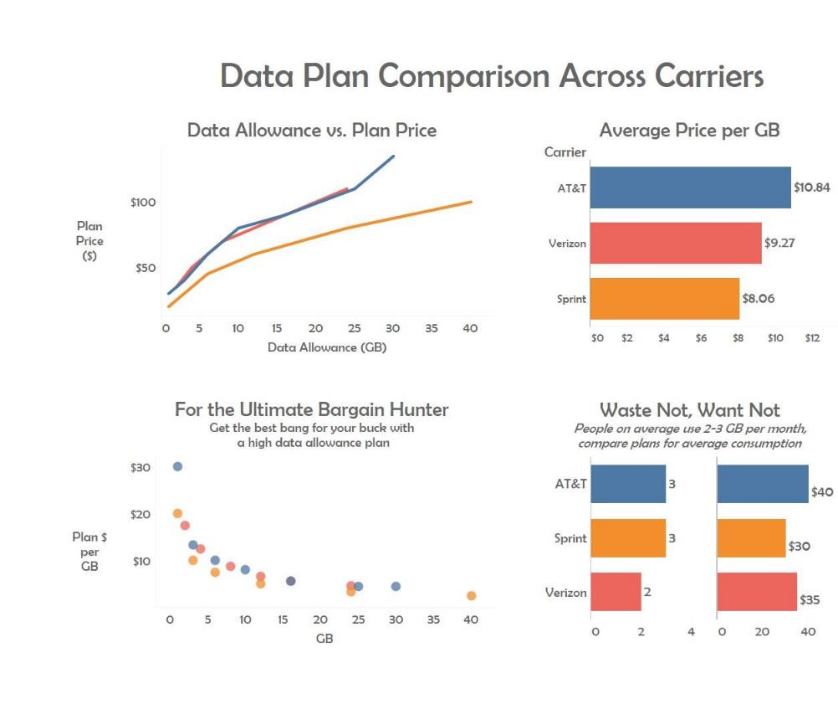

Notes:
Here is a redesign done by Angie Chen, a student at the University of Cincinnati. Angie has color coded the three carriers, keeping color consistent throughout all of the charts. The chart on the top left shows the pricing trend of the plans as the data allowance goes up. We can see that AT&T and Verizon have a similar trend, but Sprint has a clear distinction. When calculating the average price per gigabyte, Sprint also comes in the lowest. In the bottom left corner, the dots show the price of each plan at the various levels of gigabytes. This makes it easy for a bargain hunter to pick the lowest dot at whatever data plan level they would like to see. At 30 gigabytes, a user might choose AT&T, but at most other levels they would be best with Sprint. The bottom right hand chart calculates the plans based on average consumption for users.
Notice the dashboard title, the chart titles and subtitles throughout. Angie could take this a step further and give you the punchline.

Slide 23
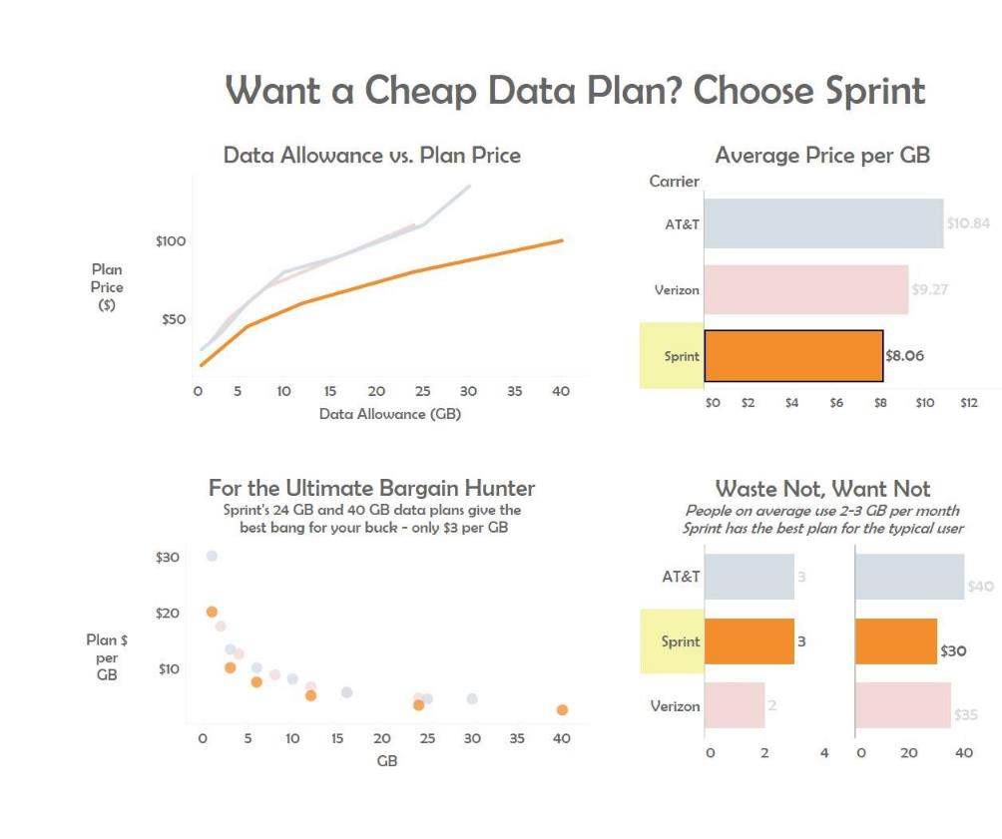
Notes:
In this version, she sets up the question and then answers it. And by highlighting the carrier, it’s easy to see where Sprint lines up versus the other carriers and why it’s the best choice for the cheapest plan.

Slide 24
Notes:
As you create your final projects, please keep these concepts in mind. Consider the audience and the message and how that is communicated in both the visualizations and the presentations.

